Slide 1

Big Project – Progress Presentation
By: Derek Chibbaro and Maggie Byers

Slide 2

Research Question & Background Information
Varsity Men's Basketball began in 1919
Conference Championships 2013 and 2015
Advanced to the Elite Eight in 2014 (NCAA D3)
How has the team's offensive and defensive ratings changed over years and which Attributes are most impacted?
How do other basketball statistics influence the accuracy of predicting the Points per Possession (PPP) rating?
Are game-level statistics (fouls, points, etc.) significantly related offensive/defensive success?

Slide 3
Tractable Data
About the datasets (2):
Synergy Sports is where all season and play-by-play data is stored in their own API for most NCAA basketball games.
Season-level data:
Years 2015 through 2023, excluding 2020 (minimal data available)
Created merged_offense and merged_defense dataframes to analyze separately, year column added
Seasondata combines both merged datasets and creates an ID to identify offense or defense
Play-by-play data:
27 games from the 2023-24 season
Includes away/home teams, score, event level description, date, offensive/defensive players on the court during each event

Slide 4
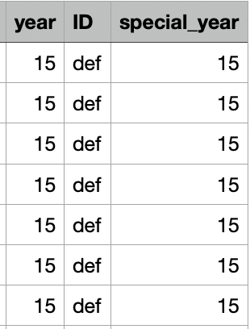
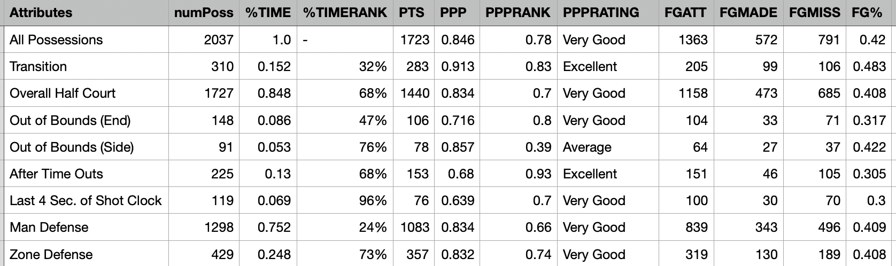
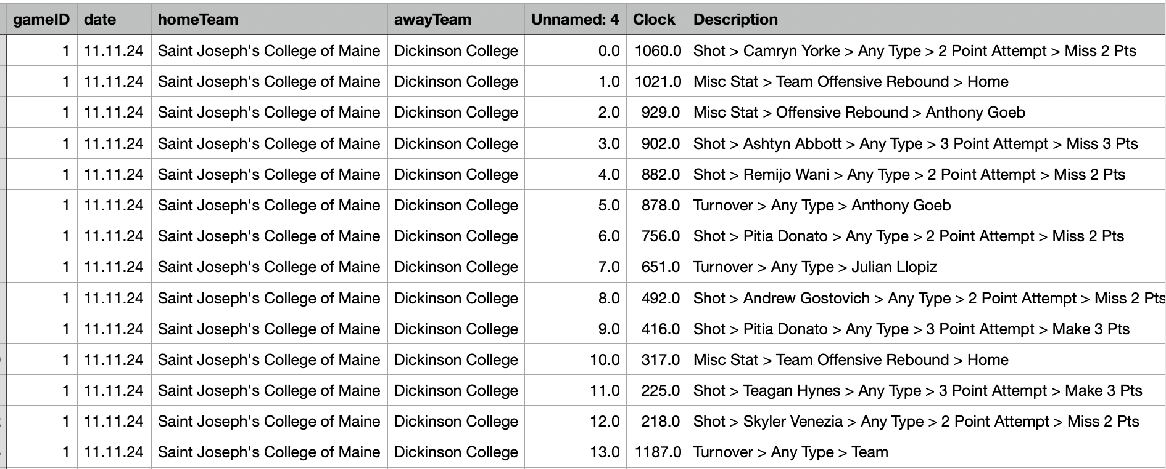
Snapshots of Datasets
Season data
Play-by-play

Slide 5
Data Retrieval
Season-level data:
Gathered by "printing" the page as a pdf and converting the pdf in Excel
Averages from the entire season at a player level and a team level
Averages of performance overall and after certain events
Divided into offensive and defensive statistics (ID column)
Contains a rating for every statistic
- poor, below average, average, good, very good, excellent
Play-by-play data:
Gathered by scraping from the Synergy Sports website --> API found when inspecting
Description of every play for each game from the 2023-24 season
Created dummy variables indicating what type of event occurred
Foul, shot, rebound, assist, turnover, block, steal

Slide 6
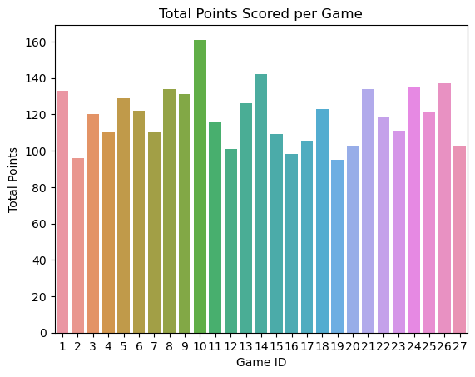
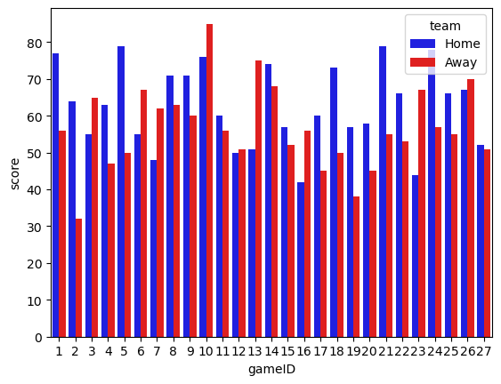
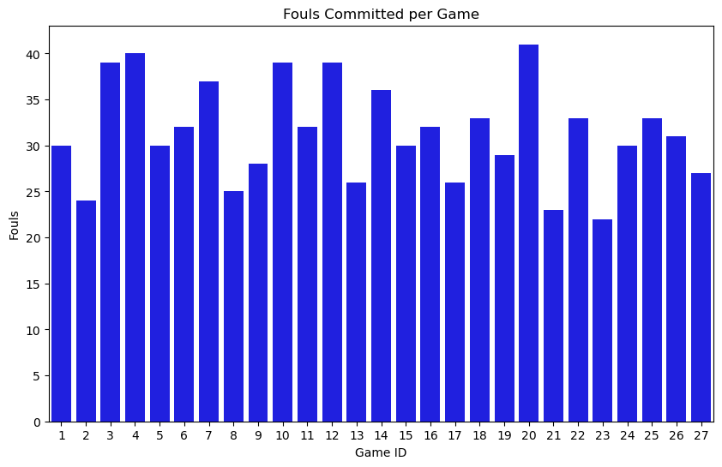
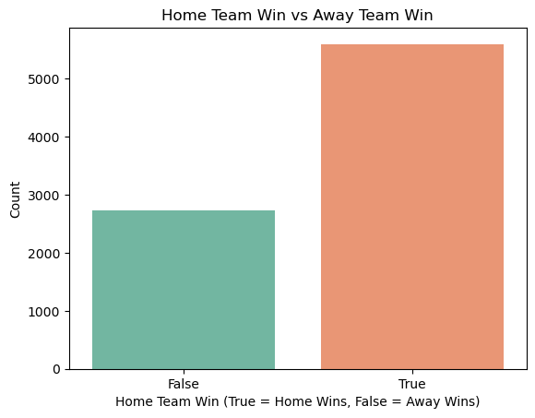
Exploratory Data Analysis (Play-by-play)
Does the team win more when committing more or less fouls?

Slide 7
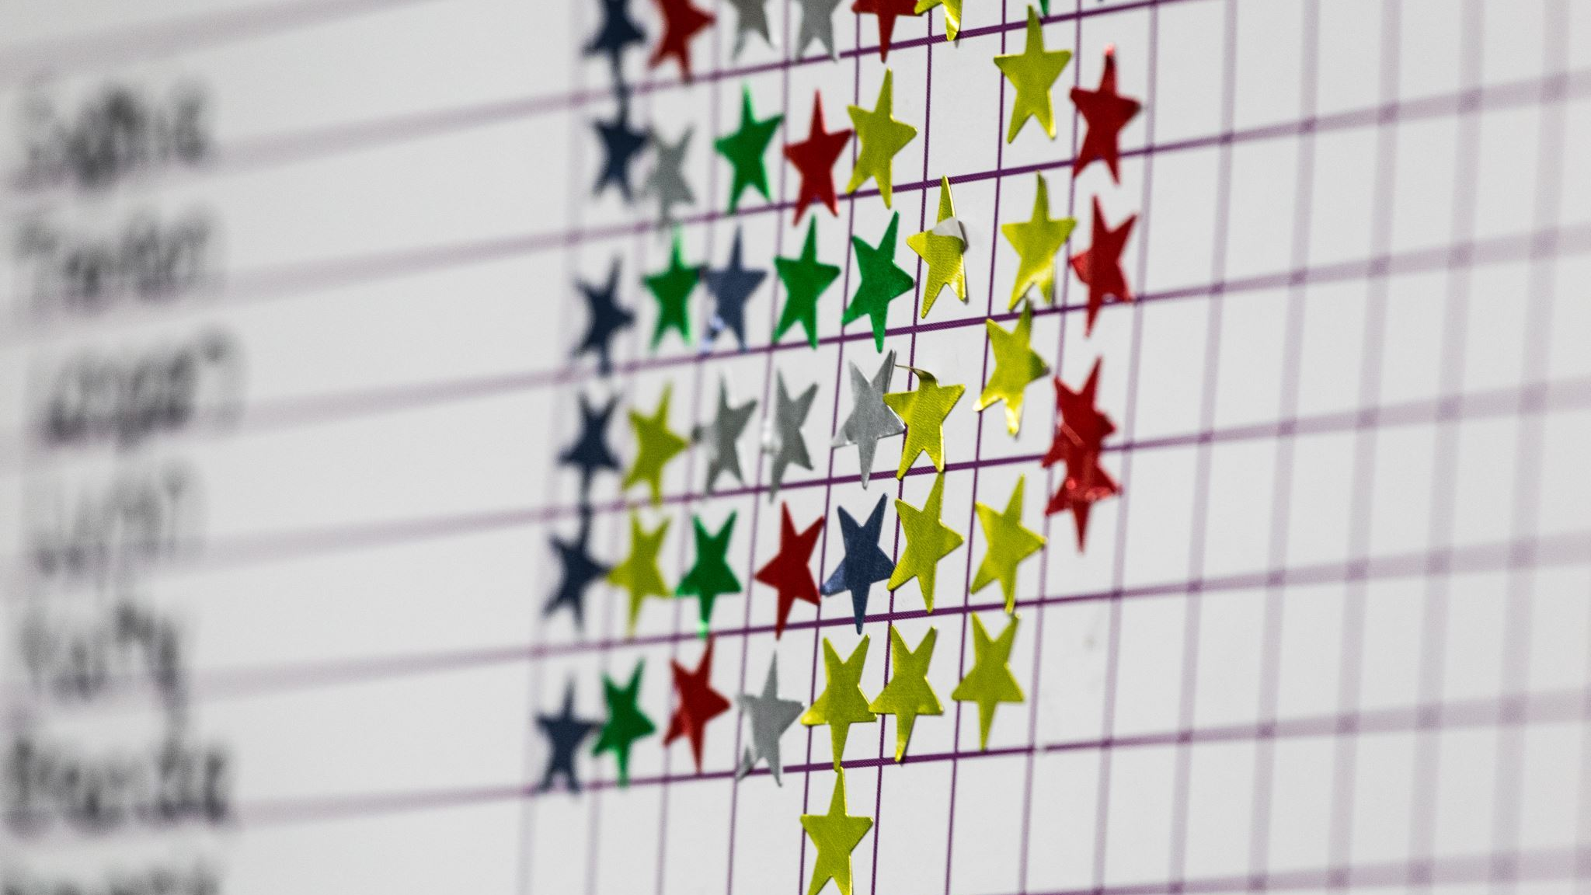
Season-Level Ratings Analysis

Slide 8
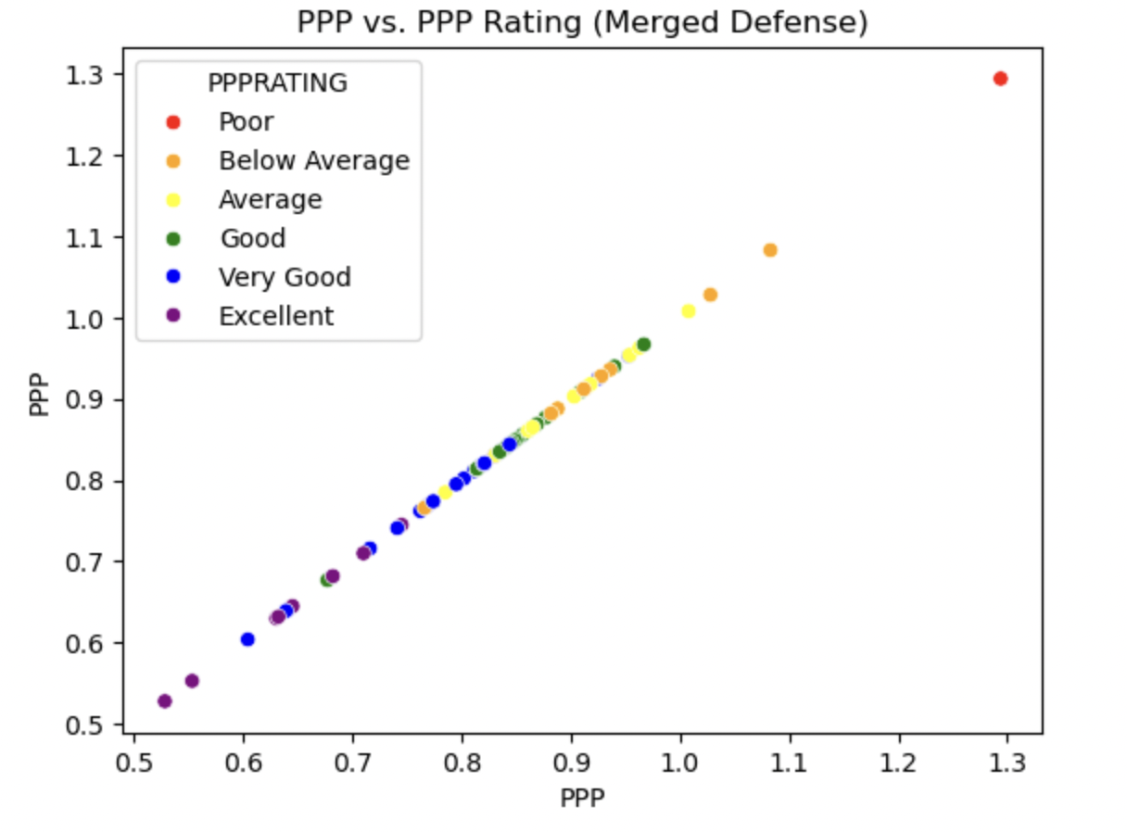
PPP and PPP Rating (DEFENSE)
PPP = Points per possession
--> Lower PPP = stronger Defense

Slide 9
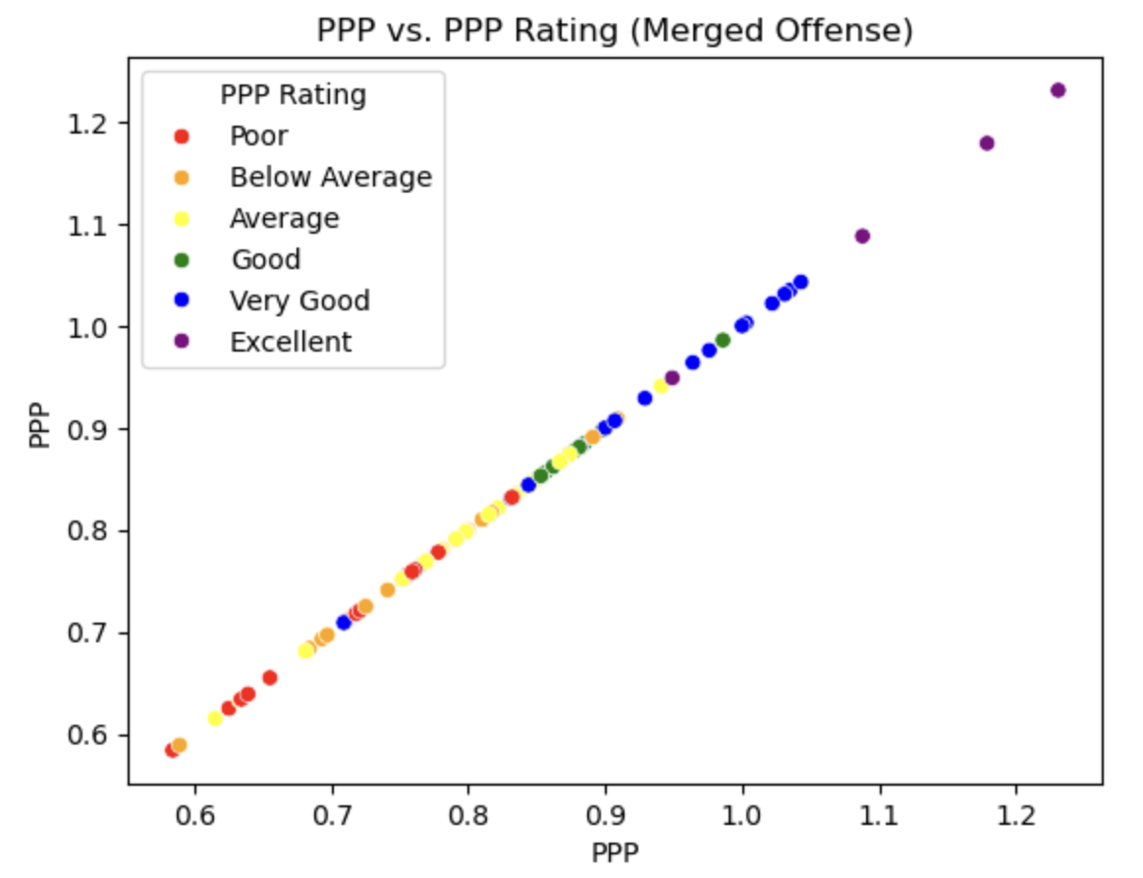
PPP and PPP Rating (OFFENSE)
PPP = Points per possession
--> Higher PPP = stronger Offense

Slide 10
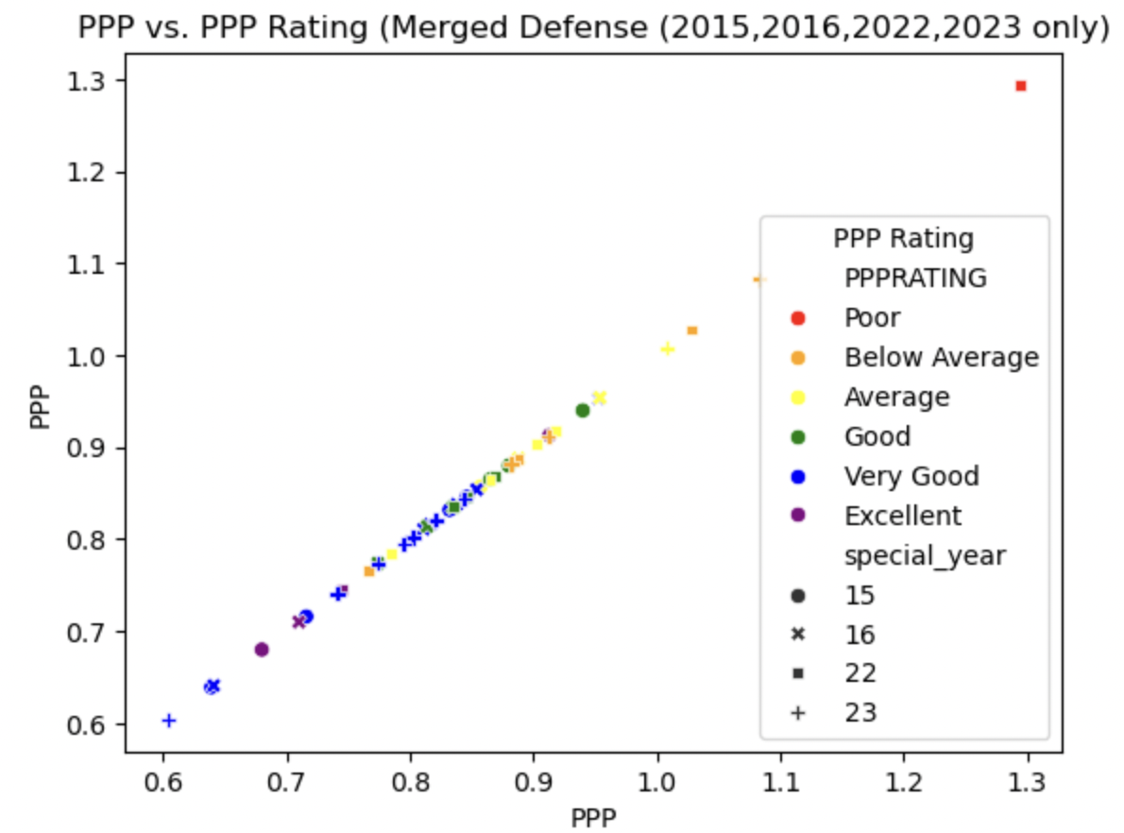
DEFENSE (2015, 2016, 2022, 2023)

Slide 11
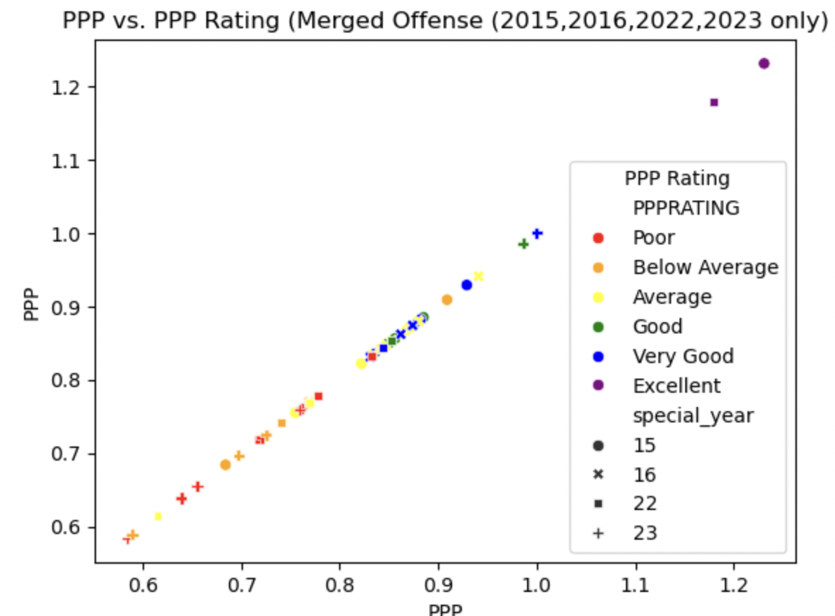
OFFENSE (2015, 2016, 2022, 2023)

Slide 12
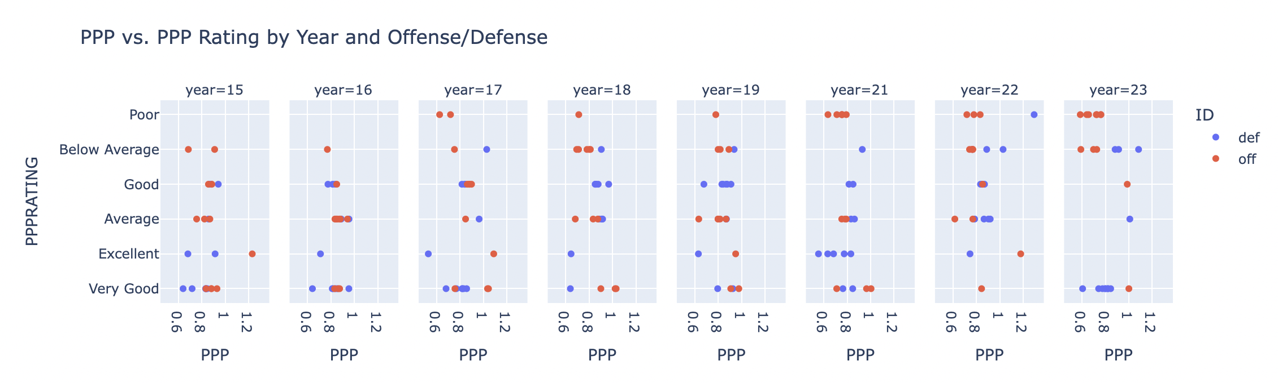
PPP Rating by Year and Offense/Defense
As time passes, there are more "poor" PPP Ratings for offensive categories and more "very good" ratings for defensive categories.

Slide 13
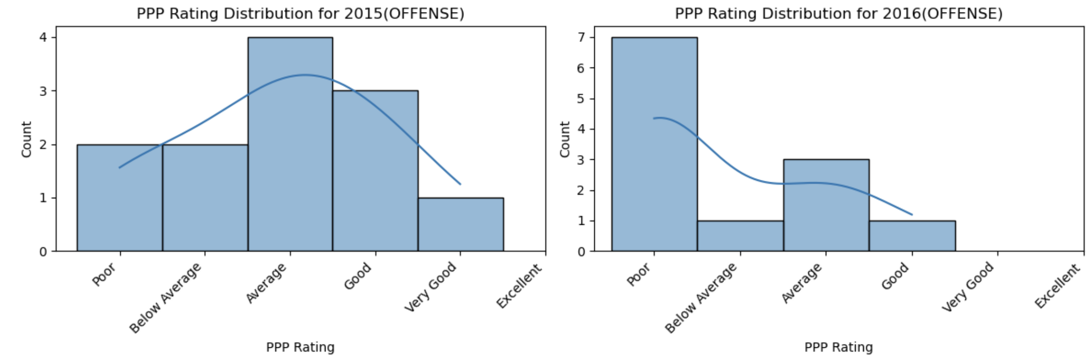
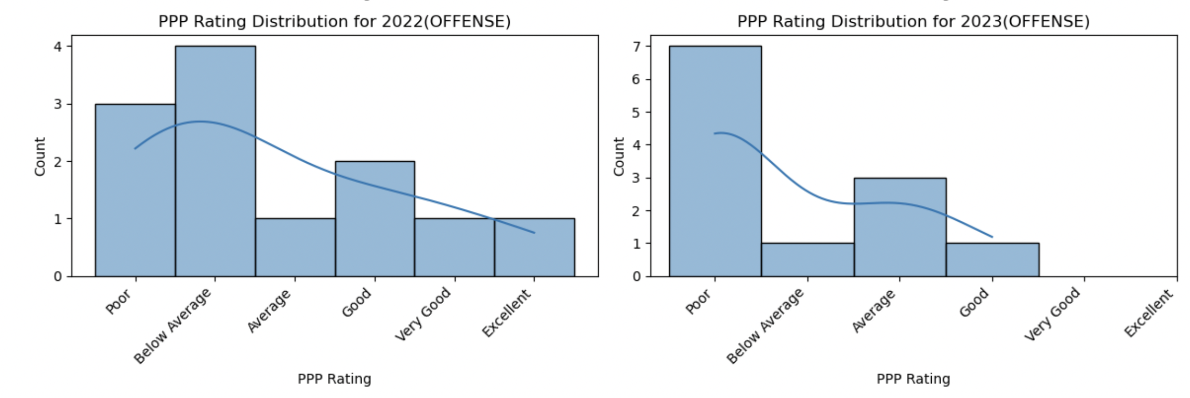
Offensive ratings for special years

Slide 14
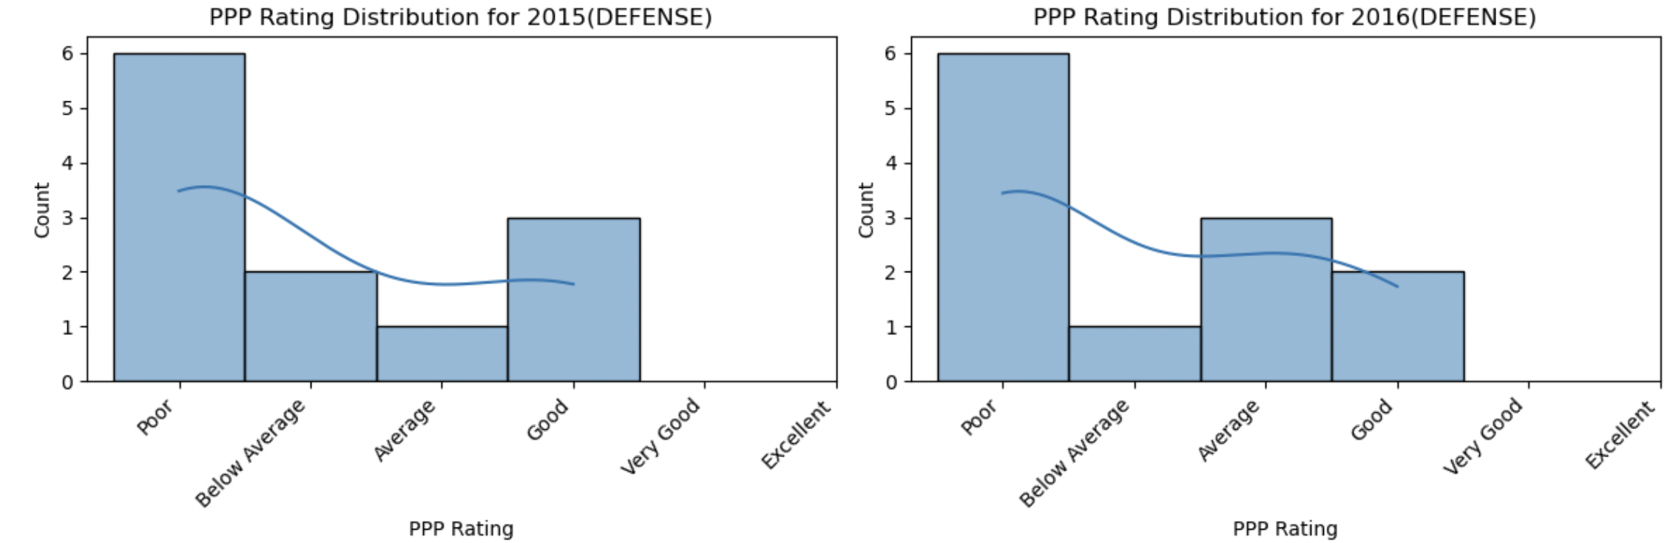
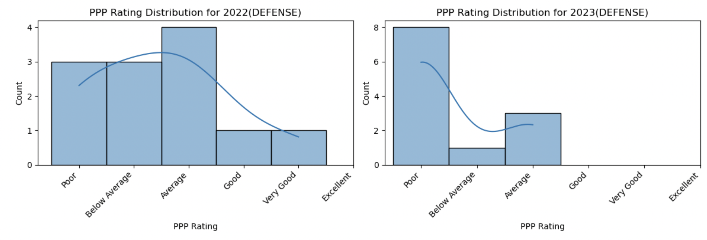
Defensive ratings for special years

Slide 15
Overall findings of preliminary analysis
Offensive categories have worse ratings as we get to more recent seasons.
Numerous factors could be associated with this, including player abilities, improving opponent defenses, conference improving.
They won conference the year before our analysis begins...both offensive and defensive categories have worsened since.
Lots of variance in fouls committed per game
Home team wins more often (as expected)

Slide 16
Model Specification
We aim to predict the PPP rating for certain seasons while accounting for Attribute (Transition, Zone defense, last 4 sec on shot clock, etc.) and other offensive/defensive variables
Regression analysis using Attribute value to predict PPP ratios.
Possibly build a model that attempts to predict the winner of a game
Unsure of what characteristics we want to use to create this model
Player statistics, season level data, past years games against each other

Slide 17
Implications for Stakeholders
These results can be used by Dickinson basketball players, coaches, opponents, or even prospective students who want to evaluate the team's past performance
Dickinson basketball can alter their practice and game plans according to certain Attributes that were found to be weak
The program could try to recruit players who balance out their weaker aspects in hopes to find better success
Athletic Directors care about wins, which data analysis can help with; wins help with fundraising and overall college reputation

Slide 18
Ethical, Legal, Societal Implications
Ethical/Legal: Note that Synergy Sports requires a subscription… we gained access through the Dickinson Men's basketball assistant coach.
Ideally we wouldn't share this with opponents but they could use the Synergy Sports platform to conduct their own analyses.
No intentions to sell results or use beyond the scope of Dickinson Athletics.
Societal: The Dickinson basketball program can get a better sense of their performance and trends from previous years. Prospective students can use the knowledge of previous success to make a decision on transferring or attending the school.

Slide 19

Thank you!!!!

